Slide 1
National Vaccine Distribution System (NVDS)

Slide 2
Problem Statement
Nationalization of vaccine distribution has been a difficult task, considering the imbalance in the adaption of technology in different departments, less knowledge on the supply and demand of vaccines, the stock in the inventories and the logistics-operational costs involved in the process of vaccine distribution resulting in the effective and timely distribution of vaccines unfeasible.

Slide 3
About NVDS
NVDS is a secure, information technology system that integrates the vaccine supply chain from purchasing and ordering through the distribution to participating hospitals, pharmacies, clinics, etc.
NVDS allows health care providers to input their vaccine requests (orders), thereby improving efficiency and accountability. The system evaluates vaccine orders against specific guidelines set by the CDC.
The main objective of NVDS is to ensure that the right vaccines are delivered in right quantities, in the right condition, at the right place, in the right time at the right cost.

Slide 4
Importance of NVDS
NVDS is integral for effectively managing and distributing vaccines. Currently, vaccine management generally consists of a mess of isolated computer applications and paper-based systems that are managed by the CDC and state-level vaccination programs. The way vaccine distributed, and inventoried are complicated and costly. Little information is known about the state of vaccine supply and demand. This leads to inefficiencies and safety problems at the provider level (hospitals and clinics).
By using NVDS we can improve the vaccine distribution and tracking drastically.

Slide 5
Solution to the Problem
The core of the solution for this problem would be to maintain a perfect communication throughout the system from the CDC to the providers and patients. So that the six rights can be achieved. NVDS will have an organizational structure for each bodies (enterprise) in the system.
Each organization will take care of specific functionalities assigned to it by the Enterprise admins.
The organizations will have many roles. A person with a certain role will carry out the actions pertaining to his role and he will be also responsible for monitoring the same.

Slide 6
Key Issues
Distribution of Vaccines.
Stock control of Vaccines and Supplies.
Financial Management.
Ensure the vaccines are stored properly and expiration dates are monitored.
Monitor the diseases that vaccines prevent.
Maintaining the insurance log of the patients.

Slide 7
Assumptions
Insurance Company will pay the insurance money for the patients.
Hospitals will have some capital to pay the distributor for the orders.
CDC will be approving the manufactures.
CDC will blacklist the manufactures if the vaccines are repeatedly damaged.
Distributor will have some capital.
CDC will have capital to pay the under insured and patients with no insurance.
CDC will have the formula to determine the allocation of vaccines to each state.
Vaccines for each disease is known.
Approximate population of each state is known.
Warehouse locations are determined by the distributor.
Satellite clinics orders are charged under the hospitals.
Patients are billed by the hospital and pharmacies.

Slide 8
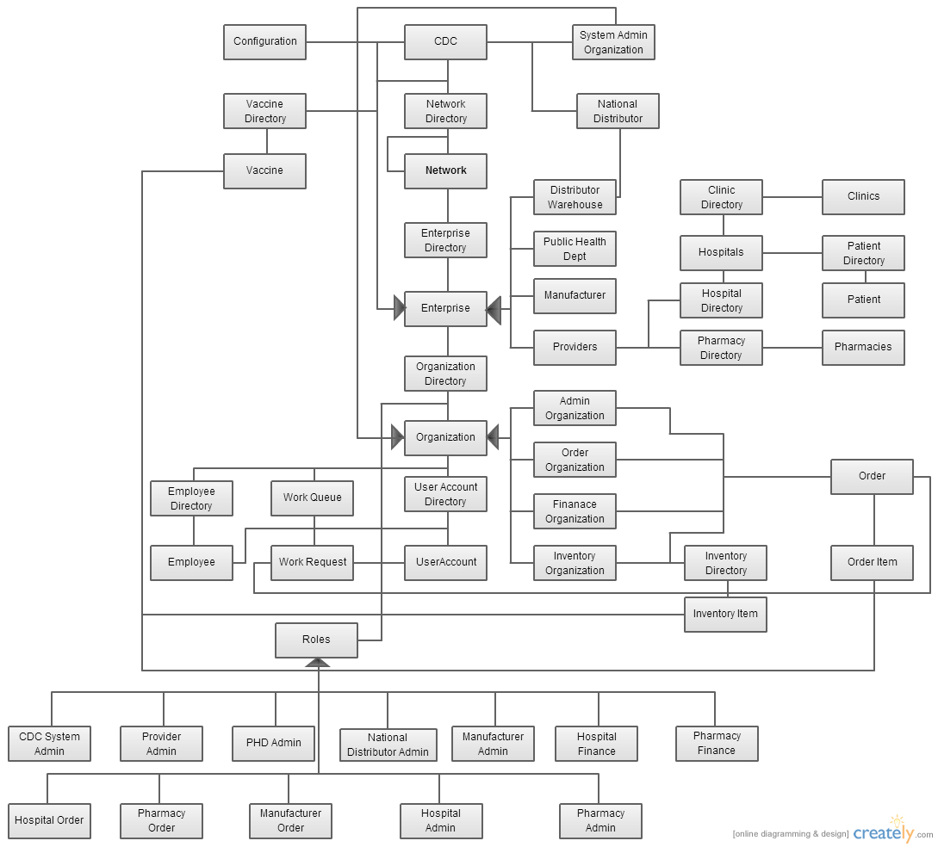
Object Model

Slide 9
Roles
CDC Admin Role –
A user assigned with this role can create networks, enterprises for the added networks.
Additionally the user can create vaccines that has to be distributed throughout the system.
He will approve the vaccine orders from the providers based on the population of each state and forwards the order request to the National Distributor.
He will cover cost of vaccine orders of the patients who are under insured or those who are not even insured.
He will blacklist the manufactures based of the reports from the providers.
PHD Admin Role –
A user assigned with this role will approve the registration requests from the providers (i.e.) Hospitals & Pharmacies.
This user will additionally approve the orders from the providers and forwards it to the CDC for further approvals.
Provider Admin Role –
A user assigned with this role will create hospital, pharmacies under that particular state and their associated users.
This user will additionally raise a report on the vaccines which are defective based on the reports from the consumer.

Slide 10
Roles
Manufacture Admin Role –
A user assigned with this role can will manufacture the vaccines based on the order request from the national distributor and bills the national distributor.
National Distributor Admin Role –
A user assigned with this role will approve the order requests from the providers (i.e.) Hospitals & Pharmacies based on the vaccines in the inventory
This user will additionally raise a order request to the manufacture for the additional vaccines.
He will also bill the providers for the order requests.
Hospital Admin Role –
A user assigned with this role will create a registration request for hospitals he is associated with.
This user will additionally add patients and clinic that comes under the hospital and pharmacies.
Hospital Order Role –
A user assigned with this role will order the vaccines for the hospital he is associated with based on the demands.
He will additionally approve the order requests from the clinic under the hospital. If the vaccines are not available in the inventory, he will raise a new order request to the distributor.

Slide 11
Roles
Hospital Finance Role –
A user assigned with this role can will pay the bills from the distributor for the order requests.
Pharmacy Admin Role –
A user assigned with this role will create a registration request for the pharmacy he is associated with.
This user will additionally add patients that comes under the pharmacy.
Pharmacy Order Role –
A user assigned with this role will order the vaccines for the pharmacy he is associated with based on the demand.
Pharmacy Finance Role –
A user assigned with this role can will pay the bills from the distributor for the order requests.
Clinic Admin Role –
A user assigned with this role will raise the request for the clinic he is associated with.
He will also handle the payments for the order requests.

Slide 12
Benefits
Benefits for CDC:
Enroll and manage providers within the formula.
Place and mange vaccine orders from the providers.
Compare health care provider vaccine orders to the original availability.
Keep track of vaccines from the manufacture, to ensure the vaccine safety.
Benefits for Distributors:
Track the approved requests.
Track the shipped orders.
Maintain the billing for providers.
Benefits for Providers:
Place and track vaccine orders.
Maintain a proper inventory for satellite clinics.

Slide 13
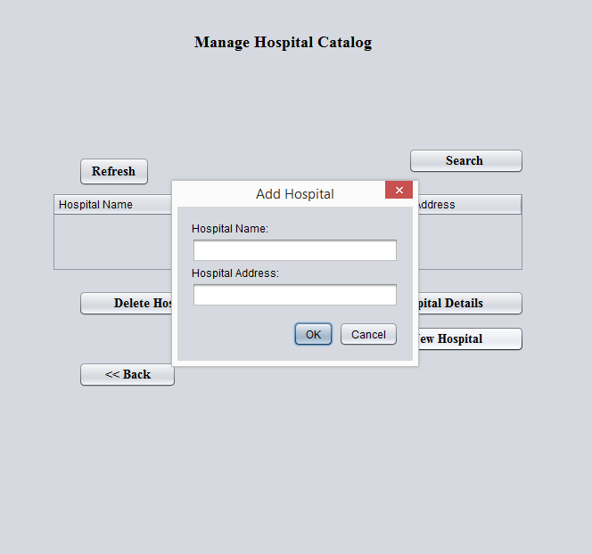
Screenshots

Slide 14
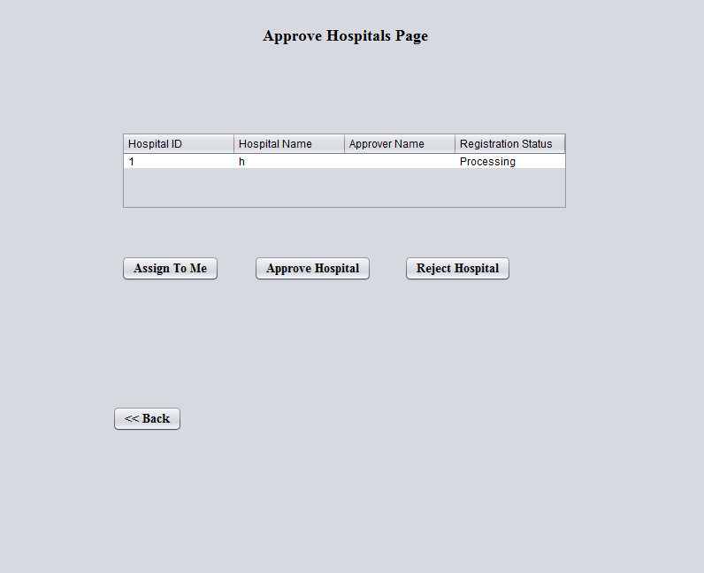
Screenshots

Slide 15
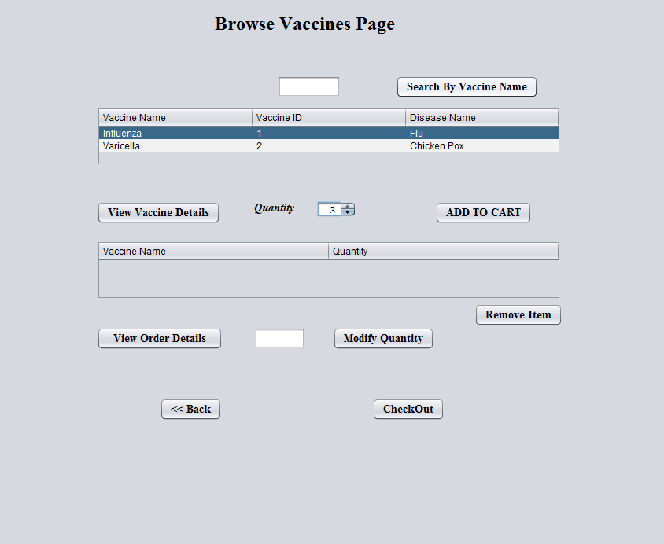
Screenshots

Slide 16
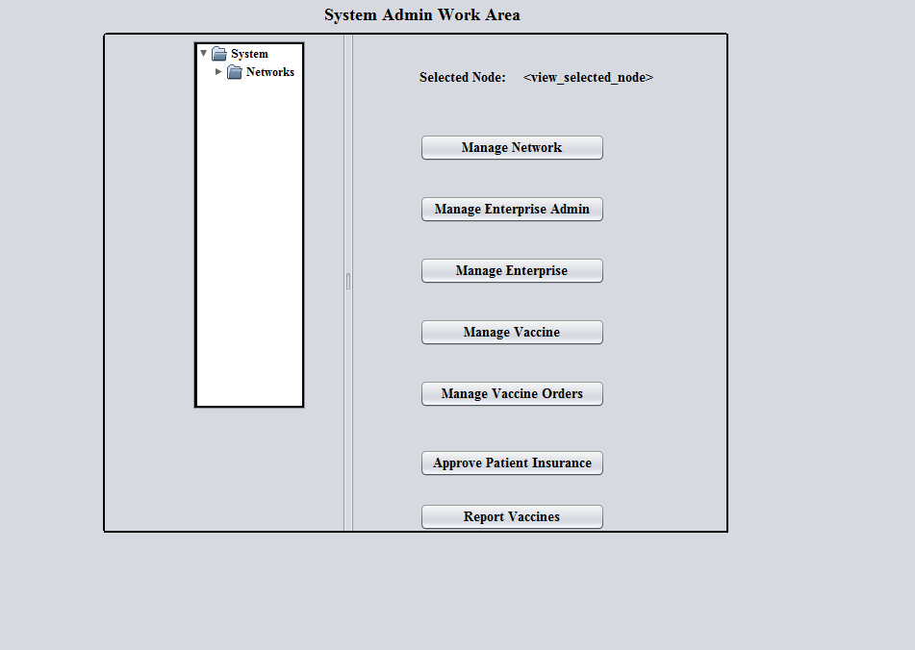
Screenshots

